Slide 1
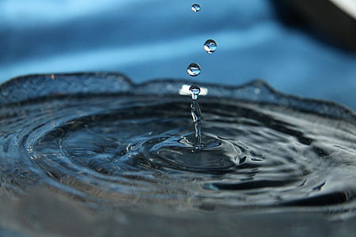
AI Guardian – Water Safety Monitoring System
Detection, Diversion, Transparency
Presented by: Lakshmilekha Pillalamarri
BS in AI & DS
Marwadi University

Slide 2
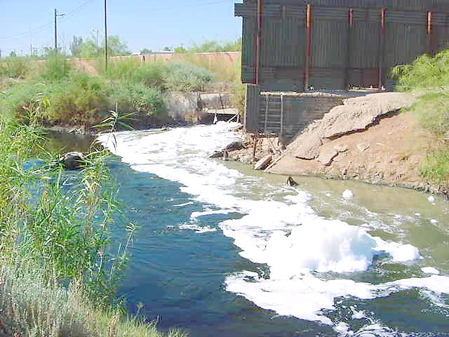
The Challenge of Water Contamination
Sewage mixing with drinking water causes health hazards.
Lack of early detection and community awareness.
Manual monitoring is slow and unreliable.
This Photo by Unknown Author is licensed under CC BY-SA

Slide 3
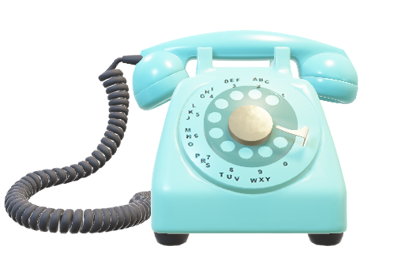

Project Objectives
Detect unsafe water using turbidity and pH sensors.
Divert sewage automatically when contamination detected.
Send SMS alerts to affected communities.
Maintain transparent records accessible to all.

Slide 4
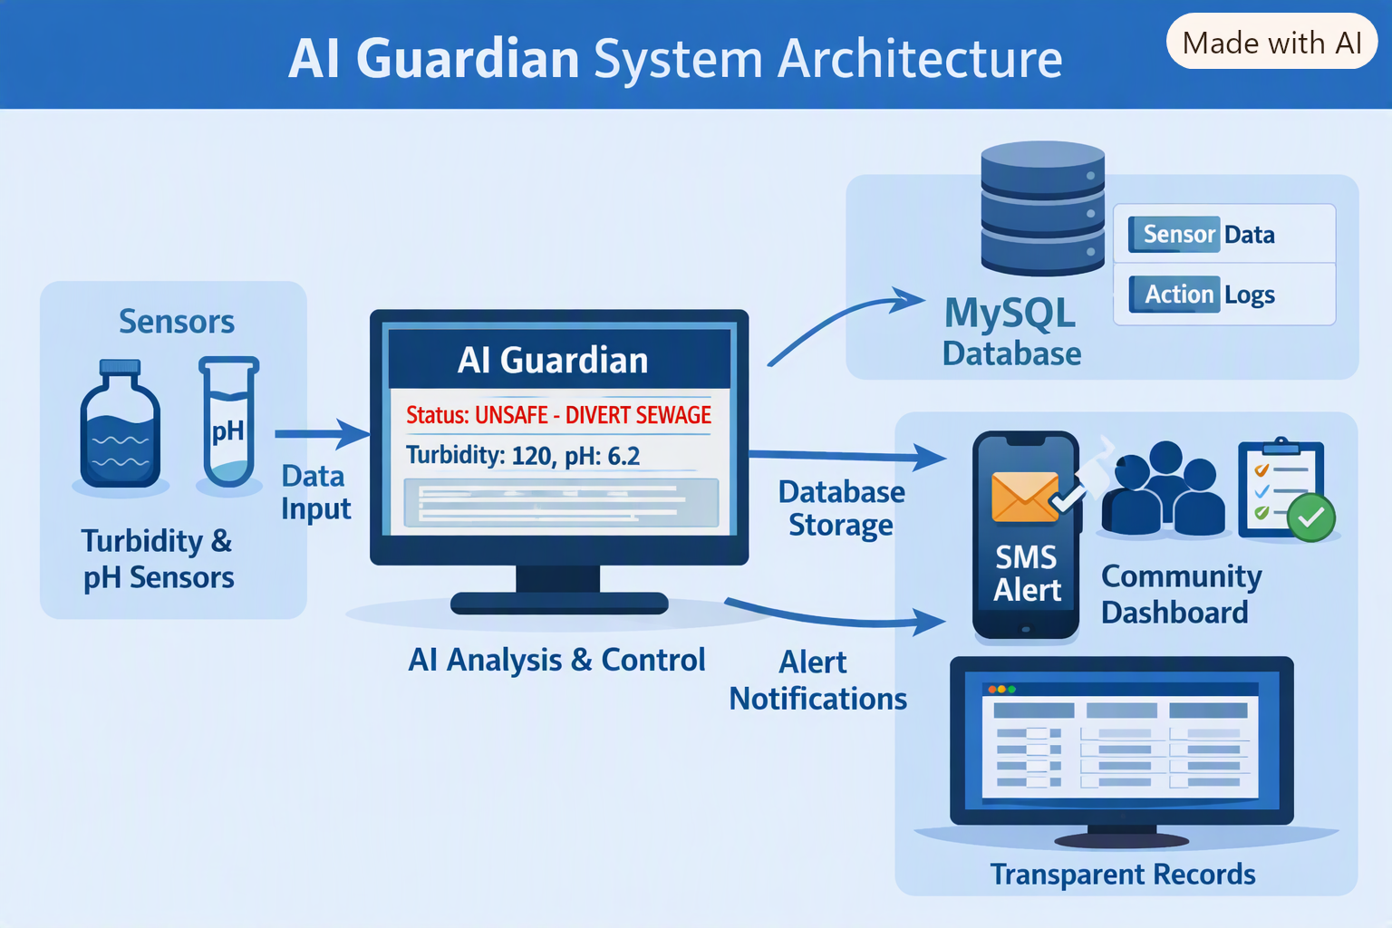
How AI Guardian Works
Sensors → AI Guardian (Python) → MySQL → SMS → Transparency Dashboard.

Slide 5
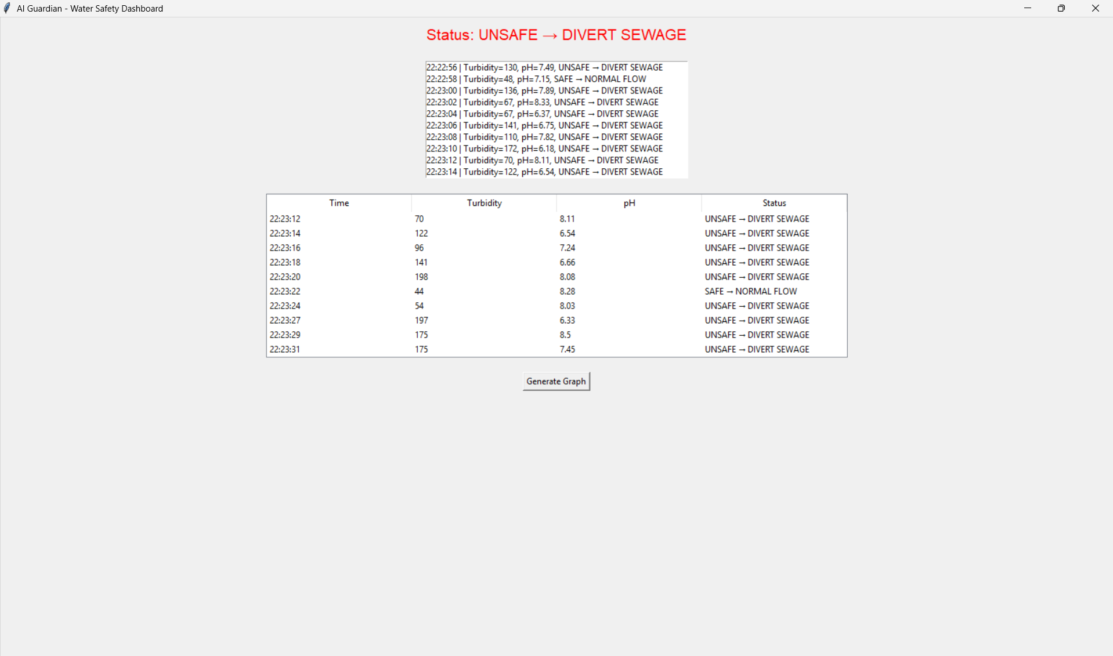
Real‑Time Monitoring Interface
Displays turbidity, pH, and status (SAFE/UNSAFE).
Logs every reading automatically.

Slide 6
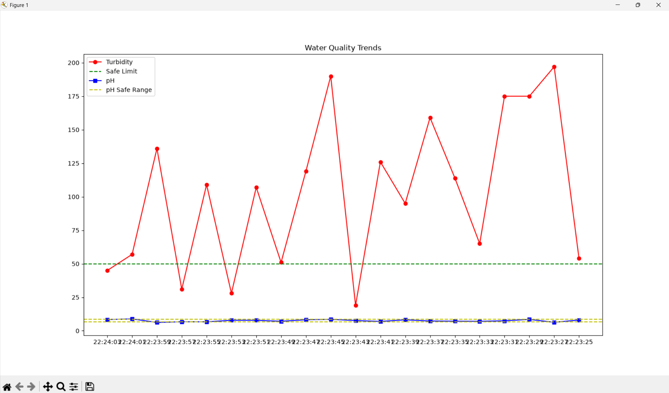
Water Quality Trends
Graph shows turbidity and pH variations over time.
Safe limits marked for quick interpretation.

Slide 7
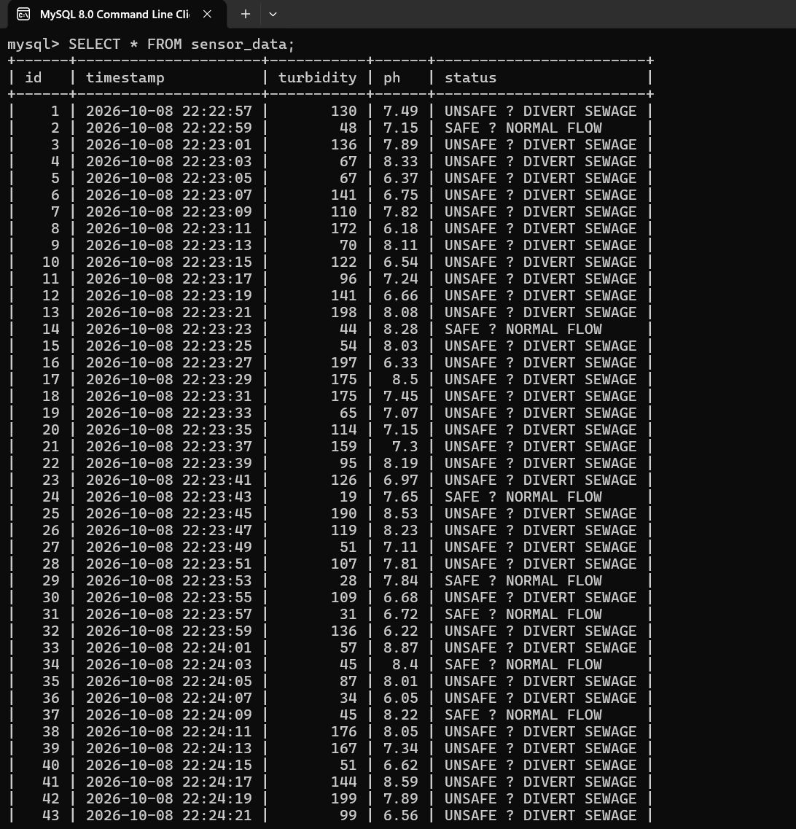
Data Storage and Logging
Sensor readings and actions stored in MySQL tables.
Ensures permanent record for analysis.
“Every reading is traceable.”

Slide 8
Transparent Records for Accountability
Tkinter table view shows all readings.
Data visible to community and authorities.
“Transparent records ensure accountability and community trust.”

Slide 9
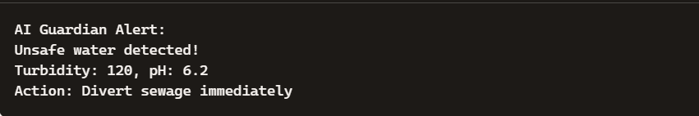
Instant Community Notifications
Unsafe readings trigger SMS alerts.
Messages sent to registered community contacts.

Slide 10
Real‑World Benefits
Prevents contaminated water supply.
Empowers communities with real‑time info.
Promotes transparency and accountability.

Slide 11
Next Steps and Improvements
Integrate IoT sensors for live data.
Use real SMS gateways (Twilio/Fast2SMS).
Build web dashboard for remote access.
Add AI prediction for contamination trends.

Slide 12
Final Thoughts
“AI Guardian ensures safe water through detection, diversion, and transparency.”

Slide 13
Thank You
Grateful for the guidance and support received during this internship project.
This work on AI Guardian reflects my learning journey in AI & Data Science
and my commitment to building solutions that ensure safe and transparent water systems.
Presented by: Lakshmilekha Pillalamarri
BS in AI & DS, Marwadi University

